Slide 1

CDBG Program Year 52 (2026)
Funding Application Guidelines & Instructions
City of Meriden, Department of Economic Development Community Development Office, Room 134
142 East Main Street, Meriden, CT 06450

Slide 2

Economic & Community Development
FEDERAL GRANT APPLICATION
The City of Meriden’s Annual Action Plan (AAP) includes the federal grant program:
Community Development Block Grant (CDBG) $900,263
Projects must primarily benefit low- and moderate-income persons or persons with special needs.
Eligible Activities:
  Public Services ($220,000 available)
  Public Facility Improvements ($68,271)
Funding is provided as a reimbursement for documented eligible expenses.

Slide 3
Application Guidelines
Eligible Applicants:
  Government agencies (public agency such as a PHA)
  Private, non-profit entity
  Faith-based Private Non-profit with IRS 501c(3) Status or equivalent
A separate application is required for each grant and each program for which your organization is requesting funding
Application Materials are posted to the City’s website at:
https://www.meridenct.gov/government/departments/economic-development/community-development/

Slide 4
Application
The application includes the following:
Application summary: project title, applicant information, amount requested
Project description: description of the project proposal, anticipated benefits to LMI residents, and goals and monitoring, proposed timeline
Estimated project budget: use of funds requested and other sources of funding.

Slide 5
Additional Requirements
The applicant organization must provide the following items:
Application
IRS Tax-Exempt Determination Letter (501(c) Status)
IRS Form 990
Organizational By-laws
Organizational Chart with employee names and titles (include a list of Board Members)
Sample organization intake/registration form
Annual Financial Statement (year-end and/or certified audit)
Proof of Registration with SAM.gov
Conflict of Interest Disclosure Form (Rev FY2025 City provided standardized template) - for each board member and program/project staff including the Executive Director/leadership of the organization

Slide 6
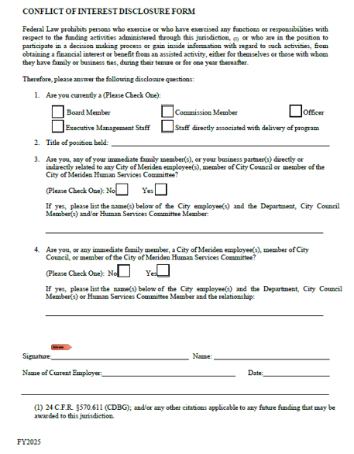
Conflict of Interest Disclosure Form
To be completed by:
Board members
Executive staff
Staff involved in the delivery of the CDBG program/project

Slide 7
Application Submission
Prospective applicants must submit the completed application to be considered.
One (1) original completed paper application, along with one (1) paper copy and a copy of the completed application submitted on a USB drive are due to the City of Meriden no later than 5:00 p.m. on Friday, May 15, 2026.
Return Applications to:
City of Meriden, Department of Economic Development Community Development Office, Room 134
142 East Main Street, Meriden, CT 06450

Slide 8
Key Dates
May 15, 2026 Deadline for applications to be submitted (5:00pm EST)
June 2, 2026 Program Year 2026 Public Hearing, 5:30 pm EST during the Human Services Committee Meeting
*Applicants are encouraged to make a brief presentation
June 2 – July 7, 2026 30-day public comment period on the 2026 Program Year Annual Action Plan
July 7, 2026 Program Year 2026 Public Hearing, 5:30 pm EST during the Human Services Committee Meeting
July 20, 2026 Council action on proposed Program Year 2026 Annual Action Plan during City Council Meeting
August 14, 2026 City of Meriden Program Year 2026 Annual Action Plan submitted to HUD no later than August 14, 2026.
**dates are subject to change**

Slide 9
Questions
City of Meriden
Department of Economic and Community
Development Office, Room 134
142 East Main Street,
Meriden, CT 06450
Contact:
Victoria Eanniello, Assistant Economic Development Director
Phone: (203) 630-4105
Email: veanniello@meridenct.gov

