Slide 1
CDBG Program Year 48 (2022)
Funding Application Guidelines & Instructions
City of Meriden, Department of Economic Development Community Development Office, Room 134 142 East Main Street, Meriden, CT 06450

Slide 2
Economic & Community Development
FEDERAL GRANT APPLICATION
The City of Meriden’s Consolidated Plan and Annual Action Plan (AAP) includes the federal grant program:
Community Development Block Grant (CDBG) ~ $1,100,000
Projects must primarily benefit low- and moderate-income persons or persons with special needs.
Eligible Activities:
Public Services ($220,000 available)
Public Facility Improvements ( $ TBD)
Funding is provided as a reimbursement for documented eligible expenses.

Slide 3
Application Guidelines
Eligible Applicants:
Government agencies (public agency such as a PHA)
Private, non-profit entity
City of Meriden departments
A separate application is required for each grant and each program for which your organization is requesting funding
Application Materials are posted to the City’s website at:
https://www.meridenct.gov/government/departments/economic-development/community-development/

Slide 4
Application
The application includes the following:
Application summary: project title, applicant information, amount requested
Project description: description of the project proposal, anticipated benefits to LMI residents, and goals and monitoring, proposed timeline
Estimated project budget: use of funds requested and other sources of funding.
Other materials: Financial Documentation and Non-profit determination, as requested on the application form. Additional project narrative and budget materials may also be submitted. Signed certifications. (part of the application)
LINK:
https://www.meridenct.gov/Customer-Content/www/CMS/files/Community_Development/CDBG_PY_48_22_Application_Fillable.pdf

Slide 5
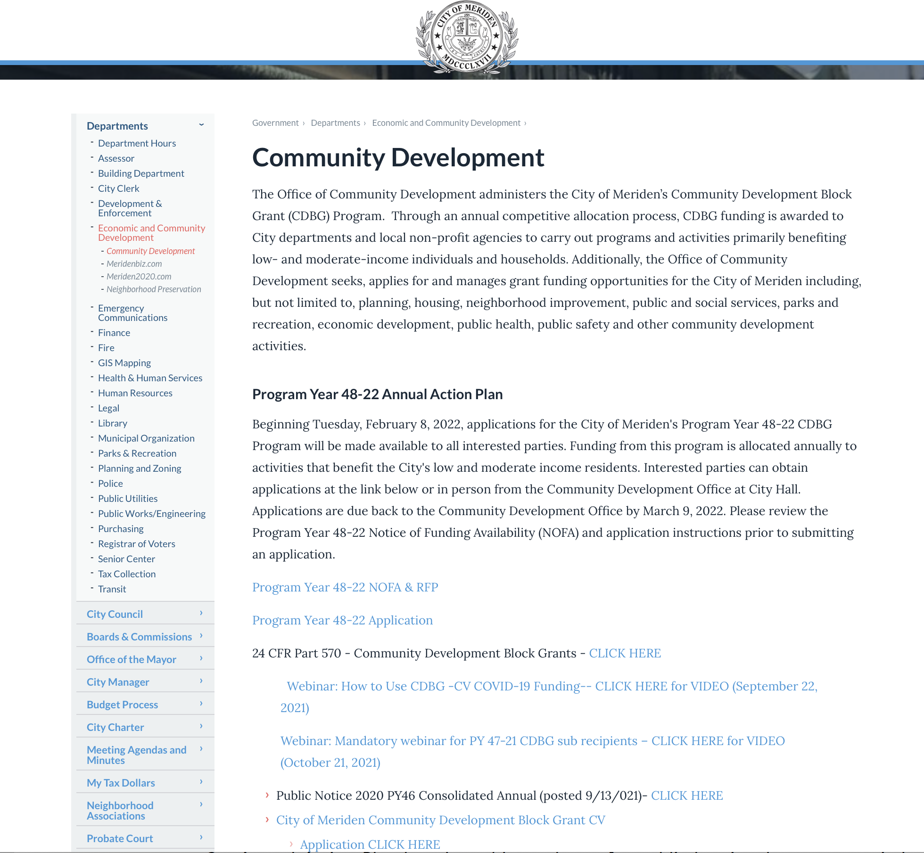

Slide 6
Additional Requirements
The applicant organization must provide the following items:
501c status
Organizational By-laws
List of current Board Members
Annual Financial Statements
Proof of Registration with the Connecticut Secretary of State
Proof of Registration with SAM.gov
SAM Unique Entity ID
No exclusions/debarments

Slide 7
Application Submission
Prospective applicants must submit the completed application form to be considered.
One (1) original and five (5) copies of the completed application are due to the City of Meriden no later than 4:30 p.m. on Wednesday, March 9, 2022.
Return Applications to:
City of Meriden, Department of Economic Development Community Development Office, Room 134 142 East Main Street, Meriden, CT 06450

Slide 8
Key Dates
March 9, 2022 at 4:30 PM – Application Due Date
March 16, 2022 at 5:30 PM (via Teams) – First Public Hearing. Attendance for applicants is mandatory.
March 30, 2022 Public Comment Period Begins (30 days)
April 20, 2022 at 5:30 PM (via Teams) – Second Public Hearing.
April 30, 2022 – Public comment period ends
May 2, 2022 – City Council Action on PY 48 (2022) AAP.
May 16, 2022 – Submission of AAP to HUD
July 1, 2022 – Program Year Start Date

Slide 9
Questions
City of Meriden
Department of Economic Development Community Development Office, Room 134
142 East Main Street,
Meriden, CT 06450
Contact: Lucy Dias, Community Development Officer
Phone: (203) 630-4105
Email: ldiaz@meridenct.gov

